Slide 1


Support Vector Machines (SVM)
Support Vector Machines (SVM)
Support Vector Machines - Wide Margin Separators

Slide 2

LINEAR DISCRIMINATION
Support Vector Machines (SVM)
Construction of a separating hyperplane

Slide 3
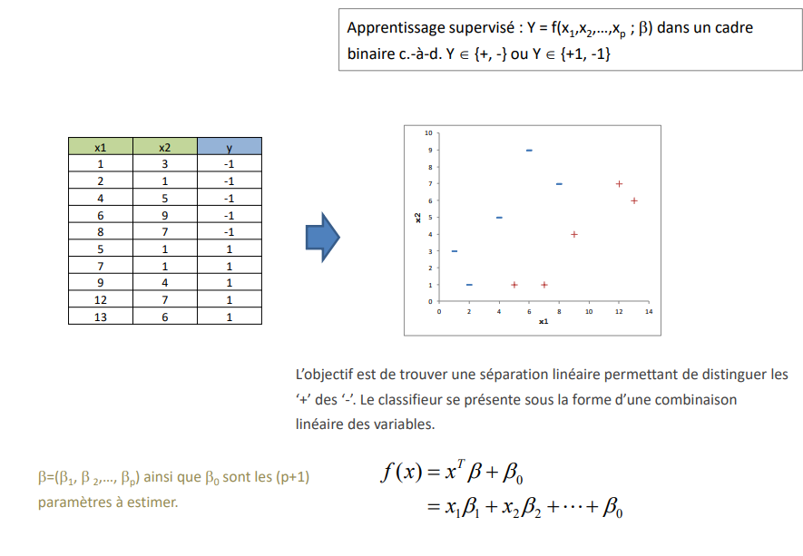
Binary discrimination Linearly separable problem
Support Vector Machines (SVM)
Supervised learning: Y = f(x1, x2, ..., xp; β) in a binary setting i.e., Y {+, -} or Y {+1, -1}
The objective is to find a linear separation allowing to distinguish the from the '-'. The classifier is presented as a linear combination of the variables.
β=(β1, β 2, ..., βp) together with β0 are the (p+1) parameters to be estimated.

Slide 4
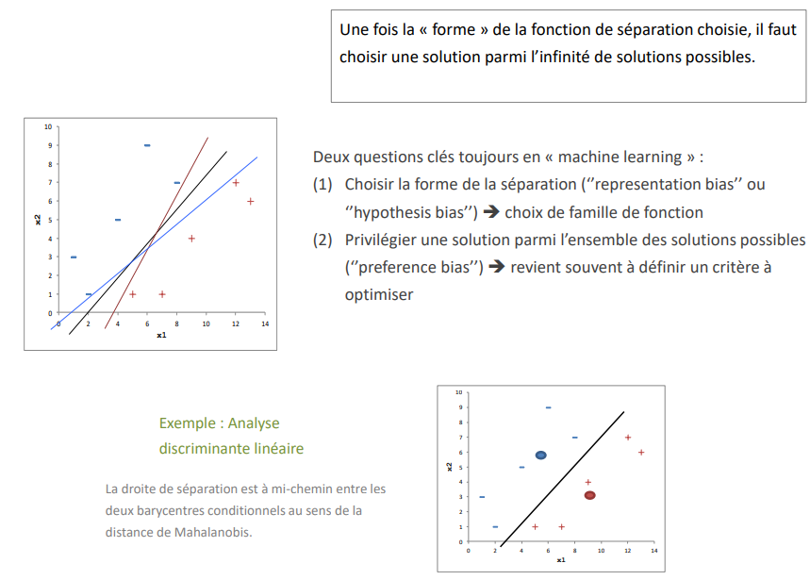
Search for the "optimal" solution
Support Vector Machines (SVM)
Once the "form" of the separation function has been chosen, we must choose a solution among the infinite number of possible solutions.
Two key questions always in machine learning:
(1) Choosing the form of the separation (''representation bias'' or ''hypothesis bias‘’) ➔ choosing a function family
(2) Preferring a solution among all the possible solutions (''preference bias‘’) ➔ often amounts to defining a criterion to be optimized
Example : Linear discriminant analysis
The separation line is halfway between the two conditional barycentre in the sense of the Mahalanobis distance.

Slide 5
MARGIN MAXIMIZATION (I)
Support Vector Machines (SVM)
First formulation

Slide 6
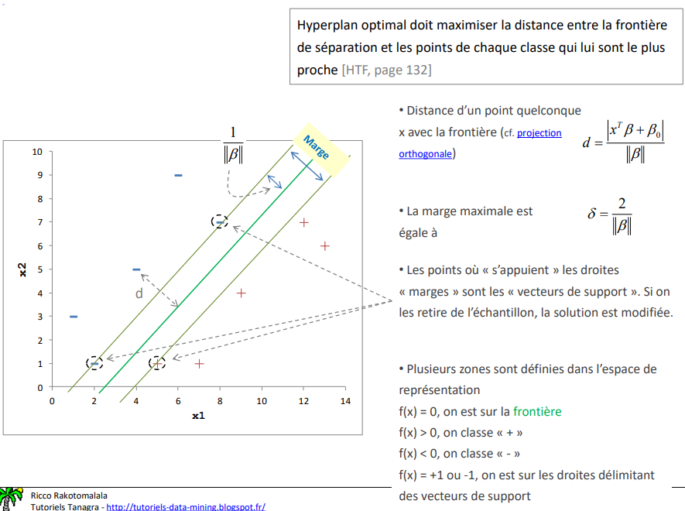
Principle of maximizing of the margin Intuitive presentation
Support Vector Machines (SVM)
The optimal hyperplane should maximize the distance between the boundary and the points of each class that are closest to it
- Distance of any point x with the boundary
- The maximum margin is equal to
- The points where the lines "rest" are The points where the "margin" lines are "supported" are the "support vectors". If we removed from the sample, the solution is modified.
- Several zones are defined in the representation
f(x) = 0, we are on the border
f(x) > 0, we classify " + ".
f(x) < 0, we classify " - "
f(x) = +1 or -1, we are on the lines delimiting support vectors

Slide 7
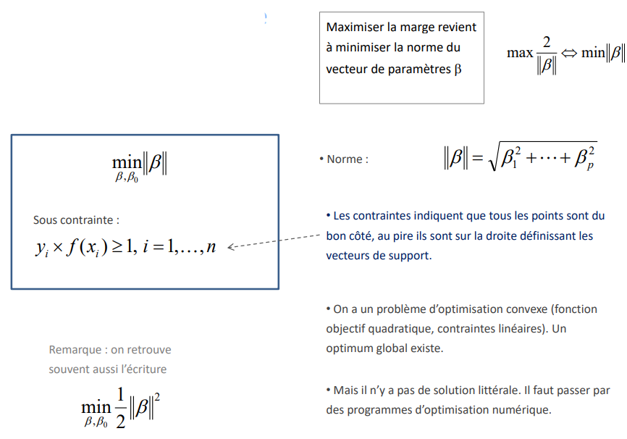
Margin maximization Mathematical formulation
Support Vector Machines (SVM)
Maximizing the margin is equivalent to minimizing the norm of the parameter vector β
- Standard:
Under duress:
- The constraints indicate that all the points are on the right side, at worst they are on the right side, at worst they are on the line defining the support vectors
- We have a convex optimization problem (objective function quadratic objective function, linear constraints). A global optimum exists.
Remark : we often find often also the writing
- But there is no literal solution. It is necessary to use numerical optimization programs.

Slide 8
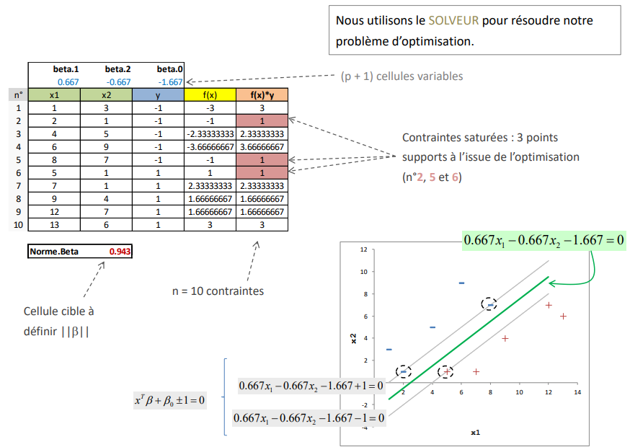
Margin maximization A toy example in EXCEL (!)
Support Vector Machines (SVM)
We use the SOLVER to solve our optimization problem.
(p + 1) variable cells
Saturated constraints: 3 points supports at the end of the optimization (n°2, 5 and 6)
n = 10 constraints
Target cell to be define ||β|||

Slide 9
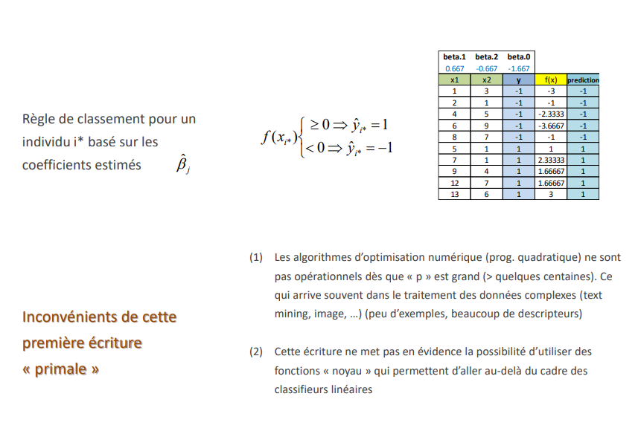
First formulation Comments
Support Vector Machines (SVM)
Ranking rule for an individual i* based on the estimated coefficients
(1) Numerical optimization algorithms (quadratic prog.) are not operational as soon as "p" is large (> a few hundred). This often happens in the processing of complex data (text mining, image, ...) (few examples, many descriptors)
(2) This writing does not highlight the possibility of using "kernel" functions that allow to go beyond the framework of linear classifiers
Disadvantages of this first writing "primal" writing

Slide 10
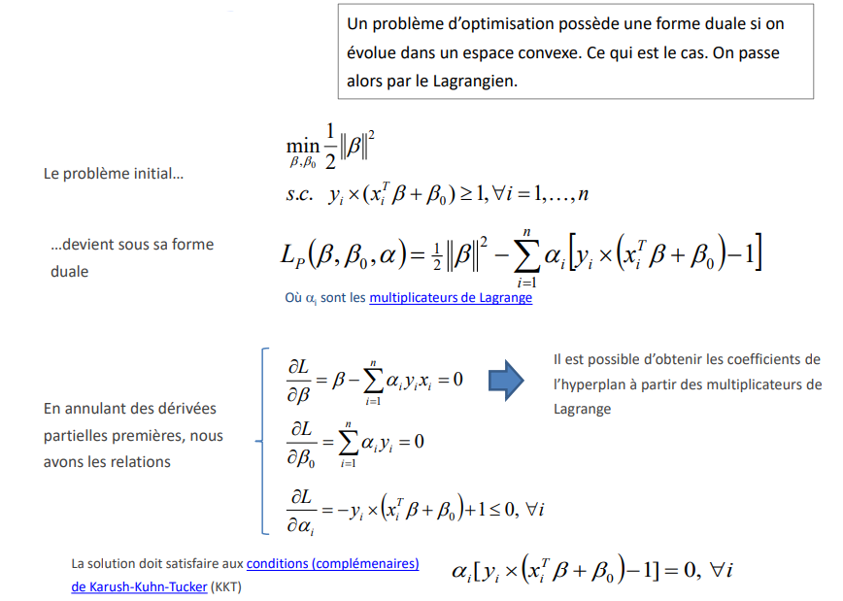
Dual expression Passage to the Lagrangian
Support Vector Machines (SVM)
An optimization problem has a dual form if one evolves in a convex space. This is the case. We pass then by the Lagrangian.
The initial problem...
...becomes in its dual form
It is possible to obtain the coefficients of the of the hyperplane from the Lagrange multipliers
By cancelling partial first derivatives partial derivatives, we have the relations

Slide 11
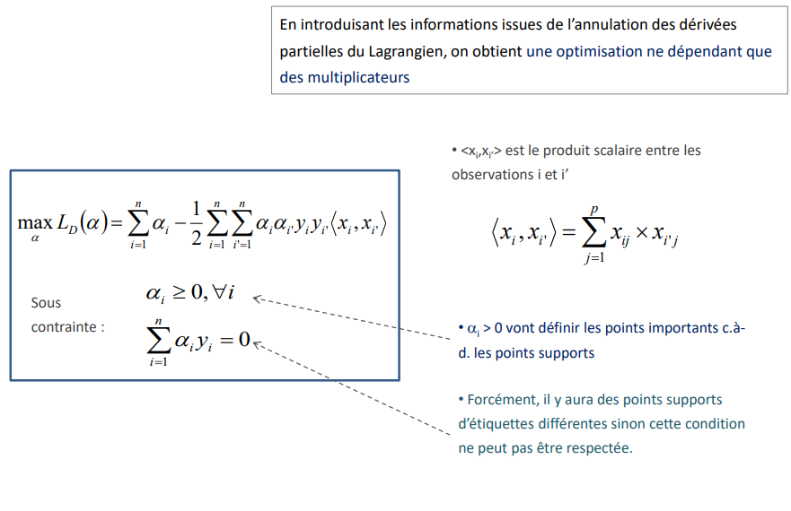
Dual Expression Optimization
Support Vector Machines (SVM)
By introducing the information from the cancellation of the partial derivatives of the of the Lagrangian, we obtain an optimization depending only on the multipliers
- <xi, xi'> is the scalar product between observations i and i'
Under
constraint :
- αi > 0 will define the important points, i.e., the support points
- Of course, there will be support points of different labels, otherwise this condition cannot be respected.

Slide 12
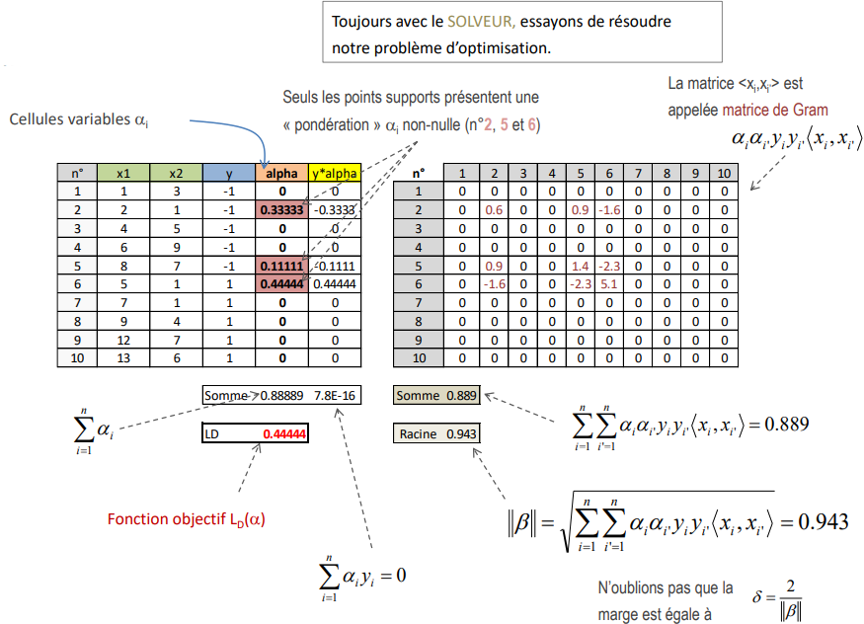
Numerical example Processing in Excel
Support Vector Machines (SVM)
Still with the SOLVER, let's try to solve our optimization problem.
Only the support points have a non-zero αi "weighting" (no. 2, 5 and 6)
The matrix <xi, xi'> is called the Gram matrix
Variable cells αi
Objective function LD(α)
Let's not forget that the margin is equal to

Slide 13
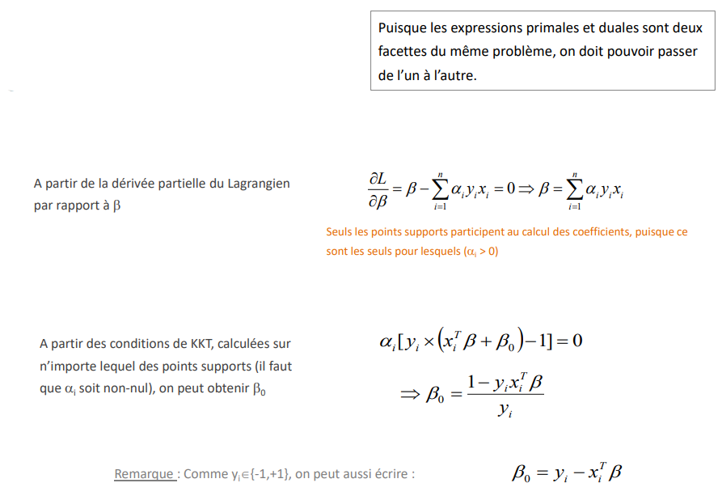
From the support points to the coefficients of the hyperplane (I) Obtaining the β-coefficients from the α
Support Vector Machines (SVM)
Since primal and dual expressions are two sides of the same problem facets of the same problem, it must be possible to switch from from one to the other.
From the partial derivative of the Lagrangian with respect to β
Only the support points participate in the calculation of the coefficients, since they are the only ones for which (αi > 0)
From the KKT conditions, computed on any of the support points (it is necessary that αi be non-zero), we can obtain β0
Note: As yi{-1,+1}, we can also write:

Slide 14
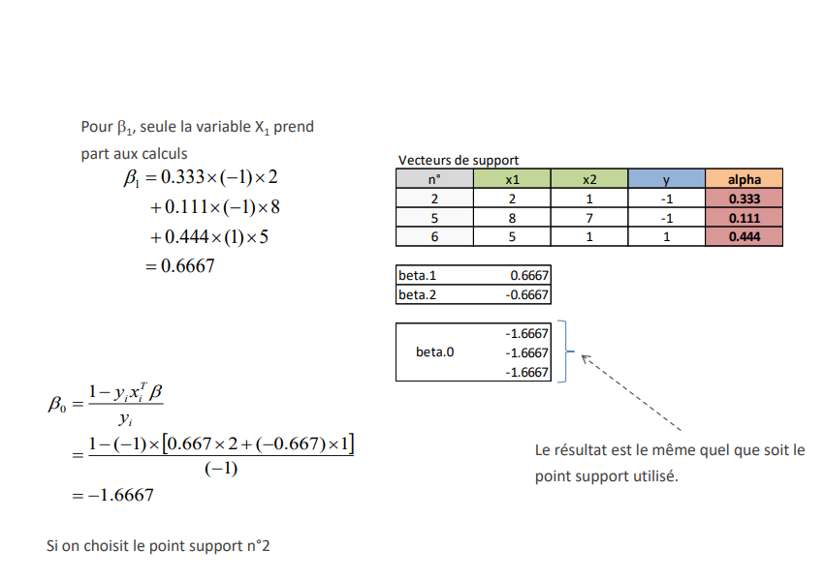
From support points to hyperplane coefficients (II) Numerical example
Support Vector Machines (SVM)
For β1, only the variable X1 takes part in the calculations
Support vectors
The result is the same regardless of the support point used.
If we choose the support point n°2

Slide 15
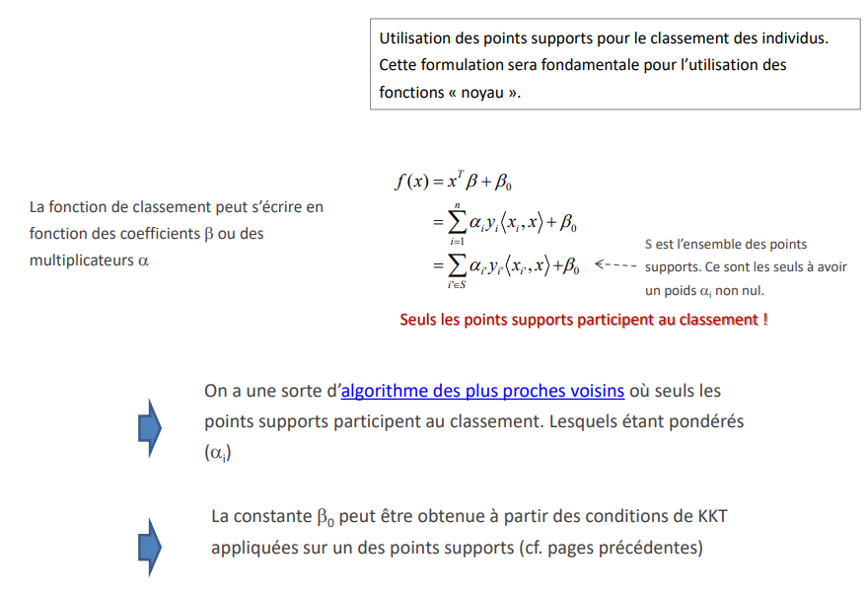
Classification of an individual additional (I) Use of support points
Support Vector Machines (SVM)
Use of support points for the classification of individuals. This formulation will be fundamental for the use of the "core" functions.
The ranking function can be written in terms of coefficients α or multipliers β
S is the set of support points. These are the only ones with non-zero weight αi.
Only the support points participate in the ranking!
We have a kind of nearest neighbour algorithm where only the support points participate in the ranking. Which being weighted (αi)
The constant β0 can be obtained from the KKT conditions applied on one of the support points (see previous pages)

Slide 16
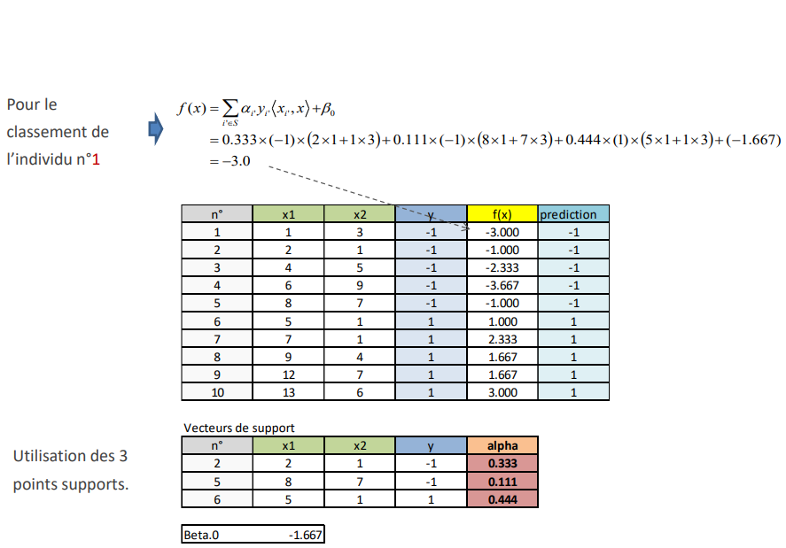
Classification of an additional individual (II) Numerical example
Support Vector Machines (SVM)
For the classification of individual n°1
Support Vectors
Use of the 3 support points.

Slide 17
Dual formulation Comments
Support Vector Machines (SVM)
1. This writing is completely consistent with the primal formulation
2. It better highlights the role of the support points with the weights αi
3. It also highlights the fundamental role of the scalar product <xi, xi'> in the calculations, this will be very important later (cf. "kernel" functions)
4. In very large dimensionalities (''p'' very high, ''n'' relatively low - image processing, text mining), this writing makes the computations simpler for optimization techniques

Slide 18
SOFT MARGIN
Support Vector Machines (SVM)
Case of imperfect separation

Slide 19
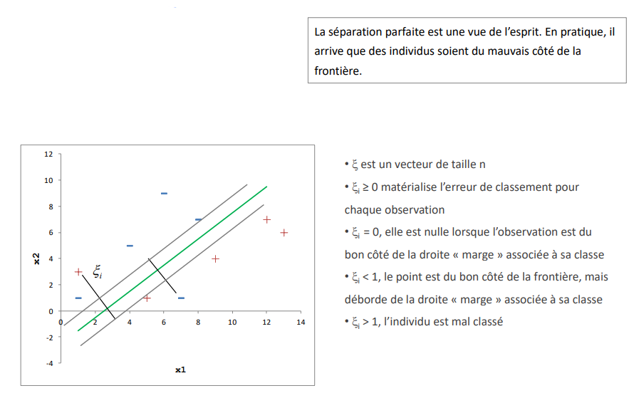
''Slack variables'' Use of slack variables ξi
Support Vector Machines (SVM)
The perfect separation is a figment of the imagination. In practice, it happens that individuals are on the wrong side of the border. border.
- ξ is a vector of size n
- ξi ≥ 0 materializes the classification error for each observation
- ξi = 0, it is zero when the observation is on the right side of the "margin" line associated with its class
- ξi < 1, the item is on the correct side of the boundary, but overflows the "margin" line associated with its class
- ξi > 1, the individual is misclassified

Slide 20
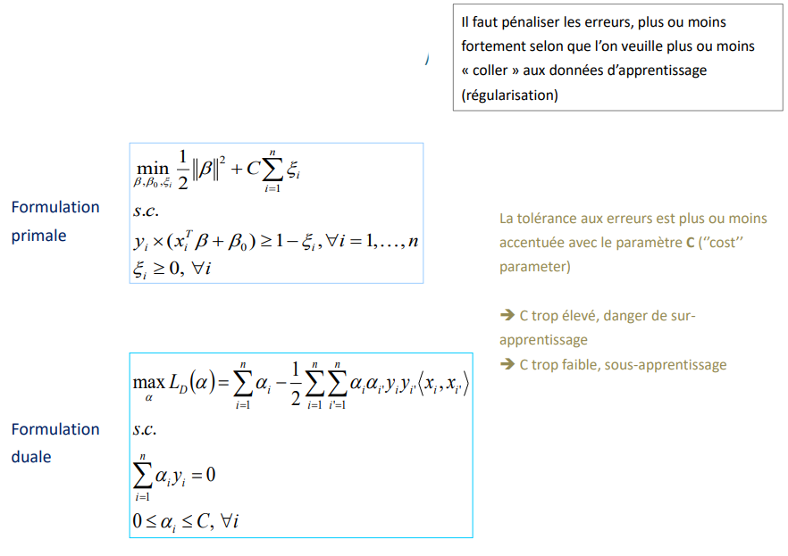
Reformulation of the optimization Introduction of the cost parameter
Support Vector Machines (SVM)
Errors must be penalized, more or less depending on whether we want to "stick" more or less to the to "stick" to the learning data (regularization)
Primal formulation
The error tolerance is more or less accentuated with accentuated with the C parameter (''cost'' parameter)
➔ C too high, danger of overlearning
➔ C too low, under learning
Dual formulation

Slide 21
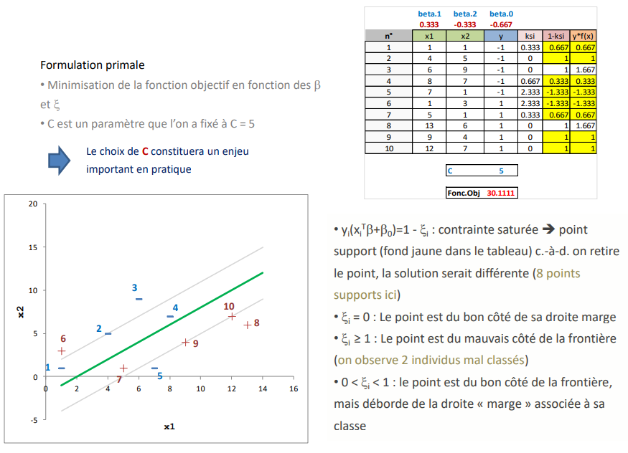
Reformulation of the optimization Introduction of the cost parameter
Support Vector Machines (SVM)
Primal formulation
- Minimization of the objective function as a function of β and ξ
- C is a parameter that we set to C = 5
The choice of C will be an important issue important issue in practice
- yi(xiᵀβ+β0)=1 - ξi: saturated constraint ➔ support point (yellow background in the table) i.e., we remove the point, the solution would be different (8 support points here)
- ξi = 0 : The point is on the right side of its margin line
- ξi ≥ 1: The point is on the wrong side of the border (we observe 2 misclassified individuals)
- 0 < ξi < 1: The point is on the right side of the border, but is outside the "margin" line associated to its class

Slide 22
NON-LINEAR DISCRIMINATION
Support Vector Machines (SVM)
The kernel trick

Slide 23
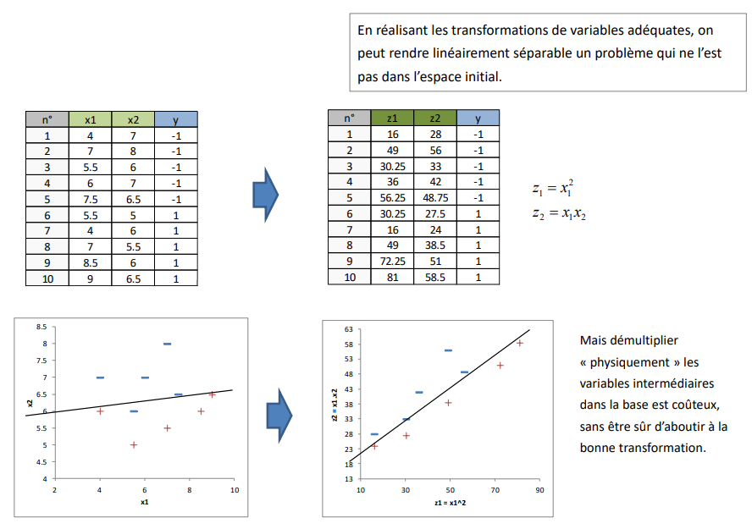
Change of representation Transformation of variables
Support Vector Machines (SVM)
By performing the appropriate transformations of variables, we can make a problem that is not a problem which is not linearly separable in the initial space. in the initial space.
But multiplying "physically" the intermediate variables in the database is expensive, without being sure to get the right transformation.

Slide 24
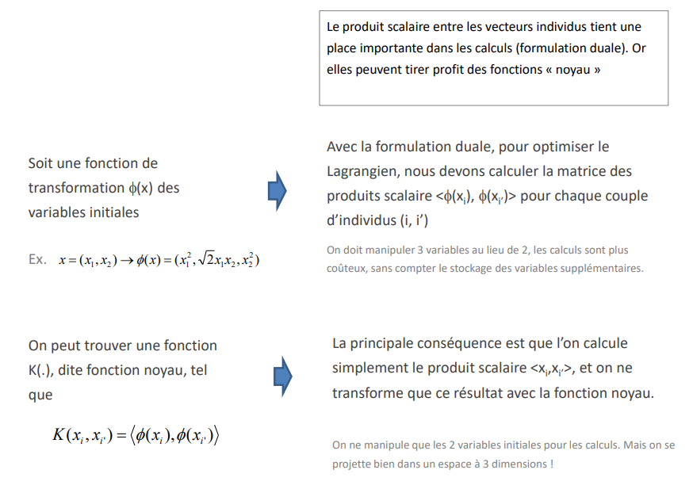
The "kernel" functions Applied to scalar products
Support Vector Machines (SVM)
The scalar product between the individual vectors plays an important role in the important place in the calculations (dual formulation). Now they can take advantage of the "kernel" functions
With the dual formulation, to optimize the Lagrangian, we need to compute the scalar product matrix <Φ(xi), Φ(xi')> for each pair of individuals (i, i')
Let there be a transformation function Φ(x) of the initial variables
We have to manipulate 3 variables instead of 2, the calculations are more not to mention the storage of the additional variables.
We can find a function K(.), called the kernel function, such that such that
The main consequence is that we compute simply the scalar product <xi ,xi'>, and we only transform only this result with the kernel function.
We only manipulate the 2 initial variables for the calculations. But we are in a 3 dimensions space !

Slide 25
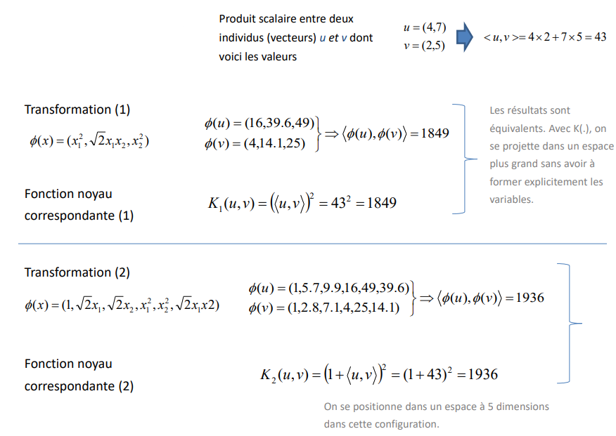
Polynomial core Examples
Support Vector Machines (SVM)
Scalar product between two individuals (vectors) u and v whose here are the values
Transformation (1)
The results are equivalent. With K(.), we project into a larger space without having to explicitly form the variables.
Kernel function
corresponding (1)
Transformation (2)
Kernel function
corresponding (2)
We can find a function K(.), called the kernel function, such that such that

Slide 26
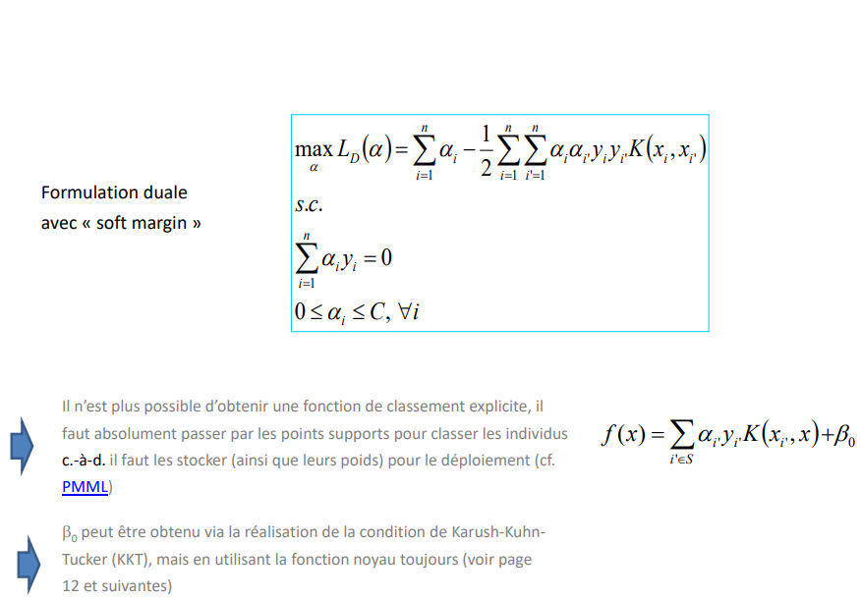
Dual formulation Use of "core" functions (core functions)
Support Vector Machines (SVM)
Dual formulation with "soft margin
It is no longer possible to obtain an explicit ranking function, it is absolutely necessary to go through the support points to rank the individuals, i.e., they must be stored (as well as their weights) for the deployment (see PMML)
β0 can be obtained via realization of the Karush-KuhnTucker (KKT) condition, but using the kernel function always (see page 12 and following)

Slide 27
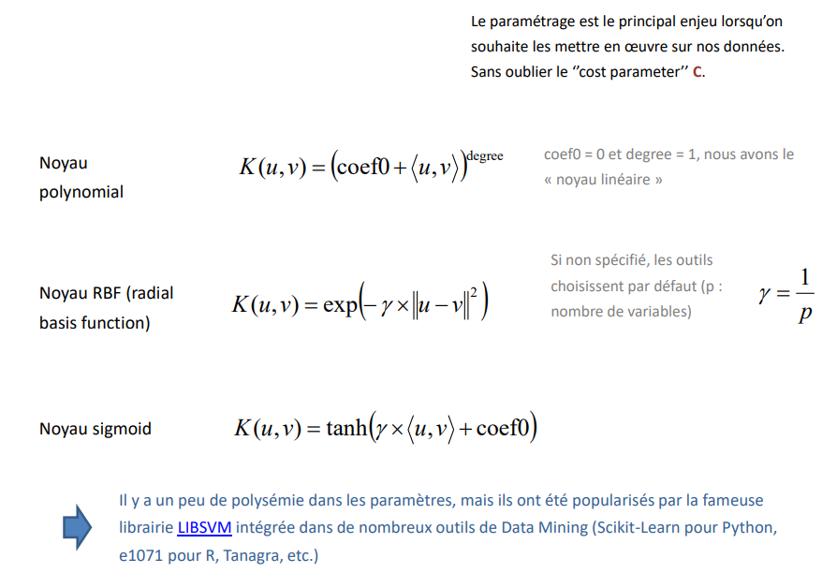
Some core functions The most used in software (ex. Scikit-learn package for Python - SVC)
Support Vector Machines (SVM)
The parameterization is the main issue when we want to implement them on our data. Without forgetting the ''cost parameter'' C.
Polynomial core
coef0 = 0 and degree = 1, we have the "linear kernel
If not specified, the tools choose by default (p : number of variables)
RBF core (radial basis function)
Sigmoid core
There is some polysemy in the parameters, but they have been popularized by the famous LIBSVM library integrated in many data mining tools (Scikit-Learn for Python, e1071 for R, Tanagra, etc.)

Slide 28

SCORE STANDARDIZATION
Support Vector Machines (SVM)
Computation of class membership probabilities
Transform the SVM output into probabilities

Slide 29
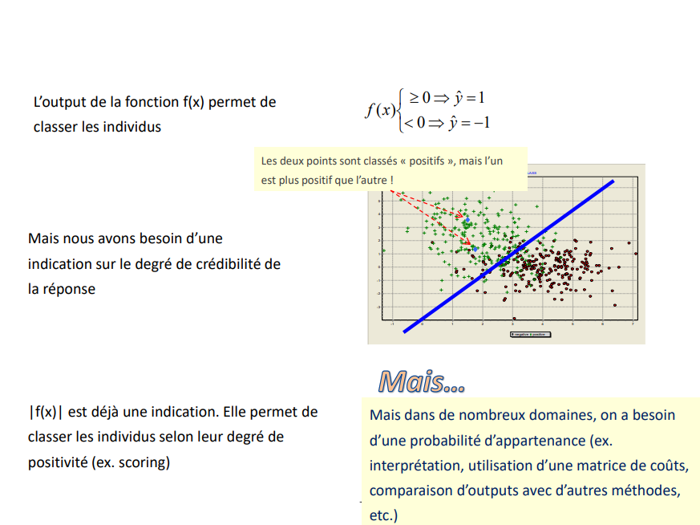
Probabilities of belonging to the classes SVM output = first version of the scores (raw scores)
Support Vector Machines (SVM)
The output of the function f(x) allows to classify the individuals
Both points are classified as "positive", but one is more positive than the other!
But we need an indication of indication of the degree of credibility of the answer
BUT…
|f(x)| is already an indication. It allows to classify individuals according to their degree of positivity (e.g., scoring)
But in many areas, we need a probability of belonging (e.g., interpretation , use of a cost matrix, comparison of outputs with other methods, etc.)

Slide 30
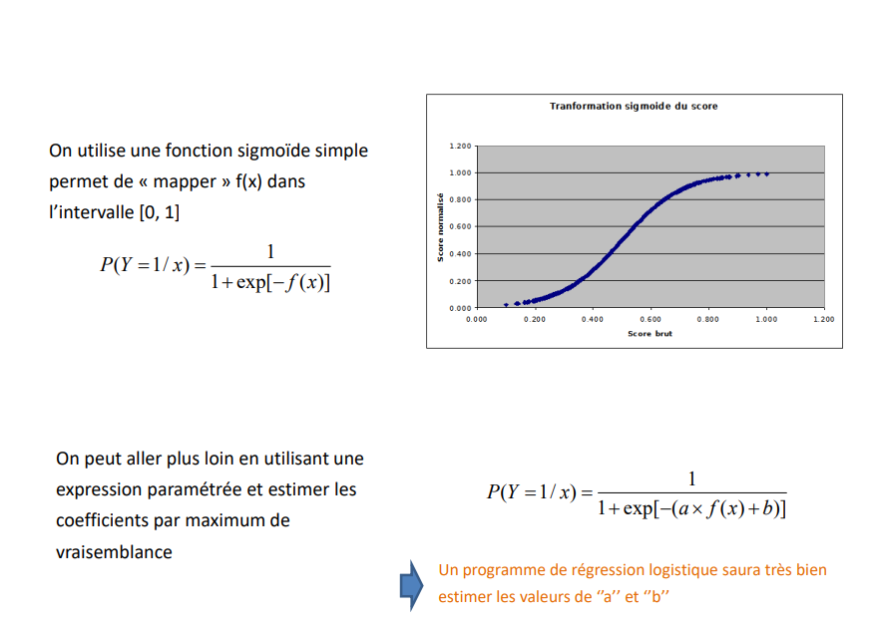
Platt's method Maximum likelihood estimation
Support Vector Machines (SVM)
We use a simple sigmoid function to map f(x) in the interval [0, 1]
We can go further by using a parameterized expression and estimate the coefficients by maximum likelihood
A logistic regression program will know very well how to estimate the values of ''a'' and ''b

Slide 31
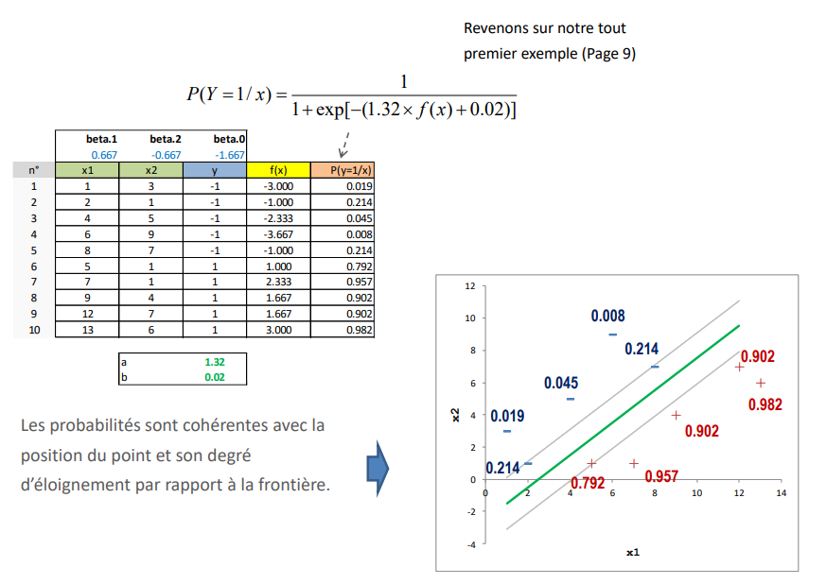
Platt's method An example
Support Vector Machines (SVM)
Let's go back to our very first example (Page 9)
The probabilities are consistent with the position of the point and its distance from the border.

Slide 32
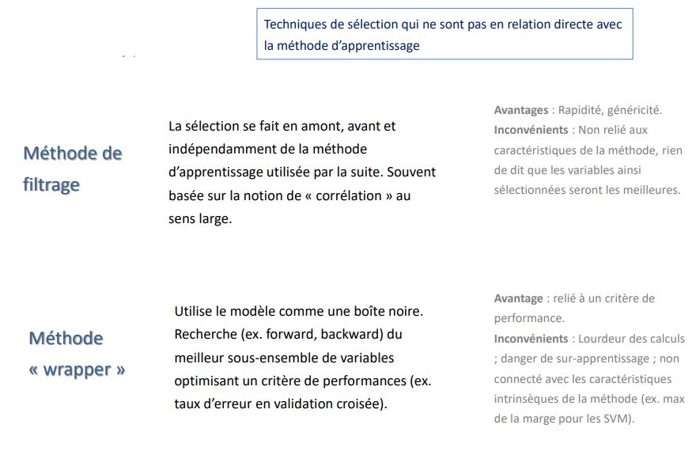
External methods Filtering and wrapper
Support Vector Machines (SVM)
Selection techniques that are not directly related to the learning method
Filtering method
The selection is done upstream, before and independently of the learning method used afterwards. Often based on the notion of "correlation" in the in a broad sense.
Advantages: Speed, genericity. Disadvantages: Not related to the characteristics of the method, nothing to say that the variables thus selected will be the best.
"wrapper" method
The probabilities are consistent with the position of the point and its distance from the border.
Advantage: linked to a performance .
Disadvantages: Computationally cumbersome danger of overlearning ; not connected with the intrinsic characteristics of the method (e.g., max of the margin for SVMs).

Slide 33
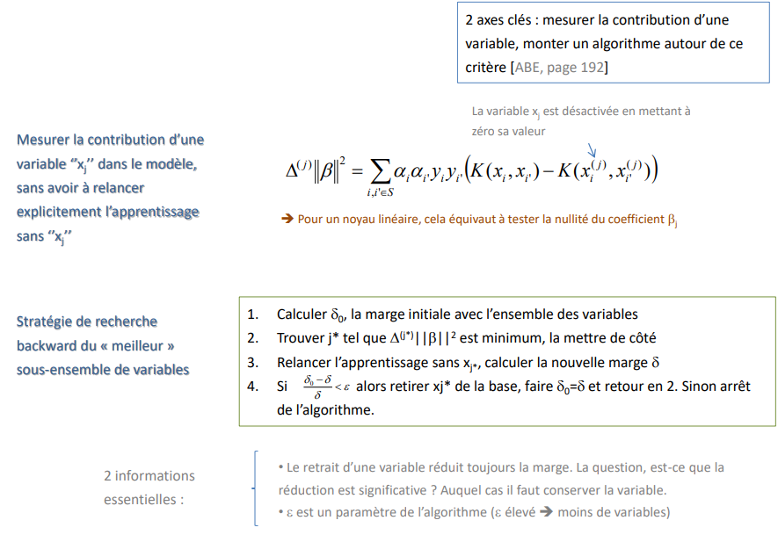
Internal method (integrated, embedded) Margin maximization criterion
Support Vector Machines (SVM)
2 key axes: measure the contribution of a variable , build an algorithm around this criterion
The variable xj is deactivated by setting its value to zero its value
Measuring the contribution of a variable ''xj'' in the model, without having to restart explicitly the learning process without ”x”
➔ For a linear kernel, this is equivalent to testing the nullity of the coefficient βj
Search strategy backward search for the “best” subset of variables
1. Compute 0, the initial margin with all variables
2. Find j* such that Δ(j*)||β||2 is minimum, set it aside
3. Rerun learning without xj*, compute the new margin
4. If then remove xj* from the base, do 𝛿0=𝛿 and return to
Otherwise stop the algorithm.
2 essential Informations :
- Removing a variable always reduces the margin. The question is, is the reduction significant? In which case the variable should be kept.
- ε is a parameter of the algorithm (high ε ➔ fewer variables)

Slide 34
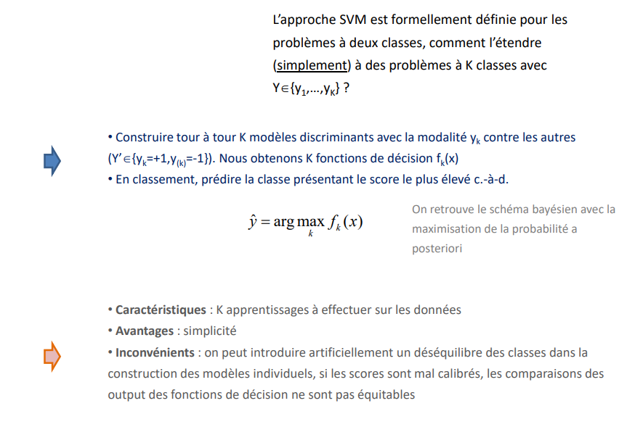
Multiclass SVM ''One-against-rest'' approach
Support Vector Machines (SVM)
The SVM approach is formally defined for two-class problems, how can we extend it to (simply) to K-class problems with Y€{y1,...,yK} ?
- Build in turn K discriminating models with the modality yk against the others (Yk{yk=+1,y(k)=-1}). We obtain K decision functions fk (x)
- In ranking, predicting the class with the highest score i.e.
We find the Bayesian scheme with the maximization of the probability a posteriori
- Features: K learnings to perform on the data
- Advantages: simplicity
- Disadvantages: one can artificially introduce a class imbalance in the construction of individual construction of the individual models, if the scores are badly calibrated, the comparisons of the output of the decision functions are not fair

Slide 35
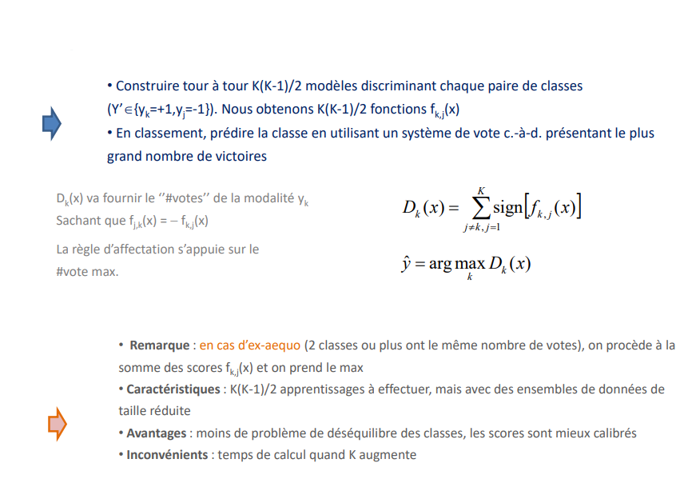
Multiclass SVM One vs. one approach (pairwise)
Support Vector Machines (SVM)
- Construct in turn K(K-1)/2 models discriminating each pair of classes (Y'{yk=+1,yj=-1}). We obtain K(K-1)/2 functions fk,j(x)
- In ranking, predicting the class using a voting system i.e., with the highest number of wins
Dk(x) will provide the ''#votes'' of the modality yk Knowing that fj,k(x) = -fk,j(x)
The assignment rule is based on the #vote max
- Note: in case of a tie (2 or more classes have the same number of votes), we proceed to the sum of the scores fk,j(x) and we take the max
- Characteristics: K(K-1)/2 learning operations to be performed, but with reduced size data sets
- Advantages: less problem of class imbalance, the scores are better calibrated
- Disadvantages: computation time when K increases

Slide 36

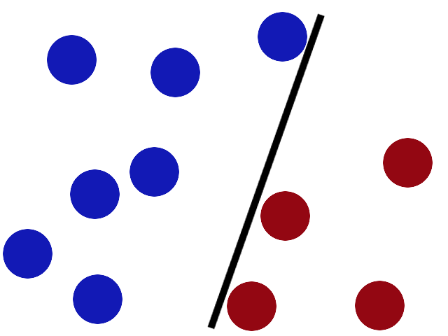
SVM IN PRACTICE
Support Vector Machines (SVM)
Software and packages - Parameterization (Python, R and Tanagra)

Slide 37
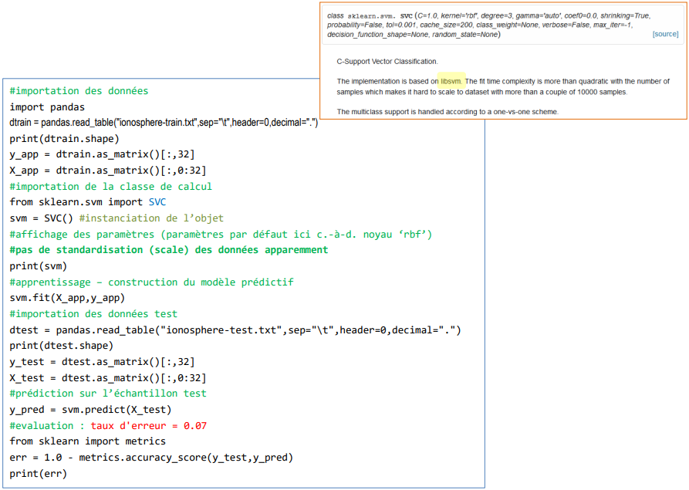
Python scikit-learn - SVC
Support Vector Machines (SVM)
#importing data
import pandas
dtrain = pandas.read_table("ionosphere-train.txt",sep="\t",header=0,decimal=".")
print(dtrain.shape)
y_app = dtrain.as_matrix()[:,32]
X_app = dtrain.as_matrix()[:,0:32]
#importation of the calculation class
from sklearn.svm import SVC
svm = SVC() #instantiation of the object
#display parameters (default parameters here i.e., core 'rbf')
#no standardization (scale) of data apparently
print(svm)
#learning - building the predictive model
svm.fit(X_app,y_app)
#import test data
dtest = pandas.read_table("ionosphere-test.txt",sep="\t",header=0,decimal=".")
print(dtest.shape)
y_test = dtest.as_matrix()[:,32]
X_test = dtest.as_matrix()[:,0:32]
#prediction on the test sample
y_pred = svm.predict(X_test)
#evaluation : error rate = 0.07
from sklearn import metrics
err = 1.0 - metrics.accuracy_score(y_test,y_pred)
print(err)

Slide 38
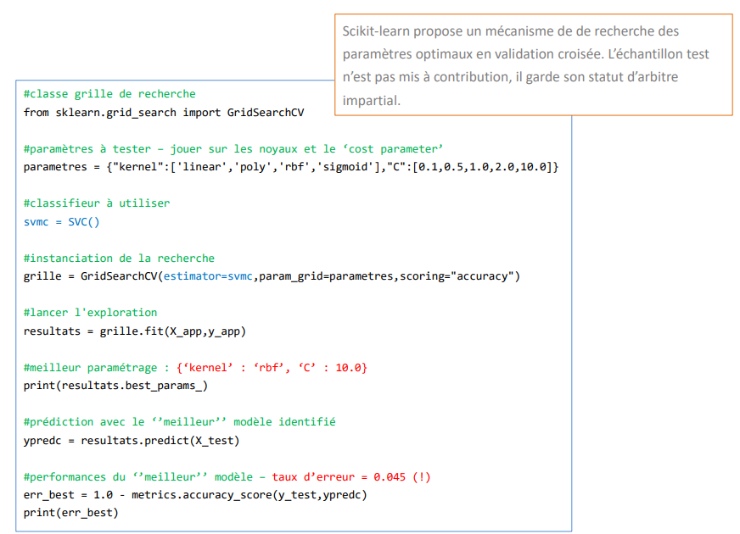
Python scikit-learn - GridSearchCV
Support Vector Machines (SVM)
Scikit-learn proposes a mechanism to search for the optimal parameters in cross validation. The test sample is not used, it keeps its status of impartial referee. impartial referee.
#search grid class
from sklearn.grid_search import GridSearchCV
#parameters to test - play on kernels and cost parameter
parameters = {"kernel":['linear','poly','rbf','sigmoid'], "C":[0.1,0.5,1.0,2.0,10.0]}
#classifier to use
svmc = SVC()
#search instantiation
grid = GridSearchCV(estimator=svmc,param_grid=parameters,scoring="accuracy")
#start the exploration
results = grid.fit(X_app,y_app)
#best_parameterization : {'kernel' : 'rbf', 'C' : 10.0}
print(resultats.best_params_)
#prediction with the ''best'' model identified
ypredc = results.predict(X_test)
#performance of the ''best'' model - error rate = 0.045 (!)
err_best = 1.0 - metrics.accuracy_score(y_test,ypredc)
print(err_best)

Slide 39
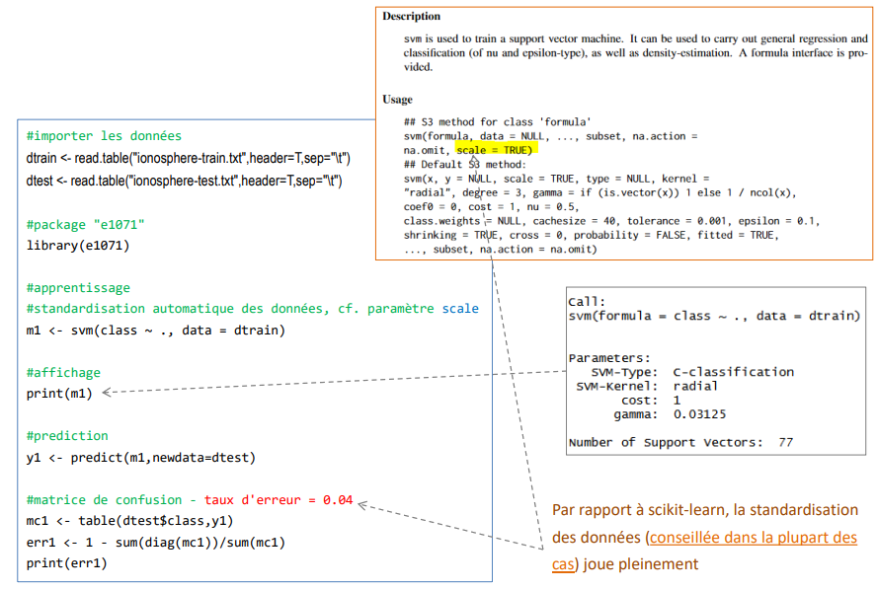
R e1071 - svm() of LIBSVM
Support Vector Machines (SVM)
#import data
dtrain <- read.table("ionosphere-train.txt",header=T,sep="\t")
dtest <- read.table("ionosphere-test.txt",header=T,sep="\t")
#package "e1071"
library(e1071)
#learning
#automatic data standardization, see scale parameter
m1 <- svm(class ~ ., data = dtrain)
#display
print(m1)
#prediction
y1 <- predict(m1,newdata=dtest)
#confusion matrix - error rate = 0.04
mc1 <- table(dtest$class,y1)
err1 <- 1 - sum(diag(mc1))/sum(mc1)
print(err1)
Compared to scikit-learn, the standardization data standardization (recommended in most cases) plays cases) is fully in play.

Slide 40
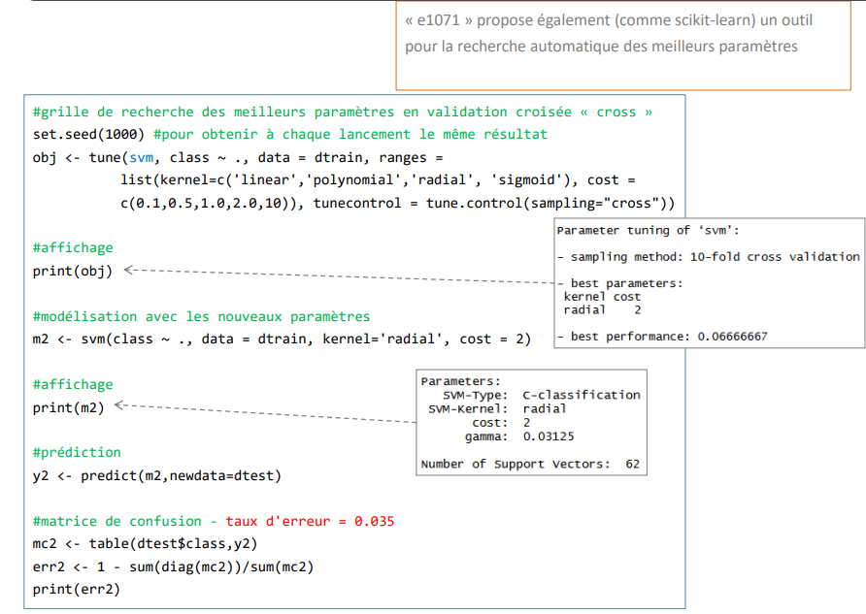
R e1071 - tune()
Support Vector Machines (SVM)
dtrain <- read.table("ionosphere-train.txt",header=T,sep="\t")
dtest <- read.table("ionosphere-test.txt",header=T,sep="\t")
#Search grid for the best parameters in cross-validation
#to get the same result every time
#printintg
#Modeling with the new parameters
#printintg
#Prediction
#confusion matrix - error rate = 0.035

Slide 41
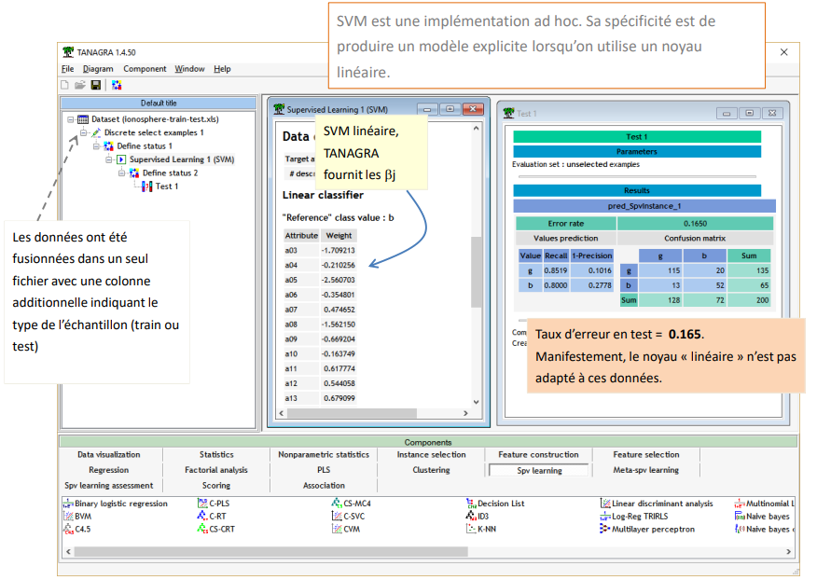
Tanagra SVM
Support Vector Machines (SVM)
SVM is an ad hoc implementation. Its specificity is to produce an explicit model when using a linear kernel.
linear SVM, TANAGRA provides the βj
The data was merged into a single file with an additional column indicating the type of sample (train or test)
Error rate in test = 0.165.
Obviously, the "linear" kernel is not adapted to these data.

Slide 42
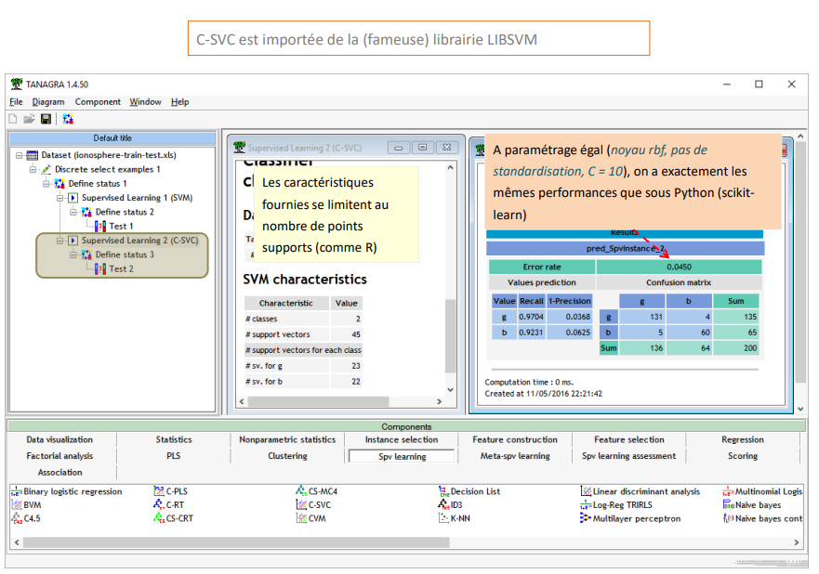
Tanagra C-SVC
Support Vector Machines (SVM)
C-SVC is imported from the (famous) LIBSVM library
With the same parameters (rbf kernel, no standardization, C = 10), we have exactly the same performance as with Python (scikitlearn)
The characteristics provided are limited to the number of support points (like R)

Slide 43
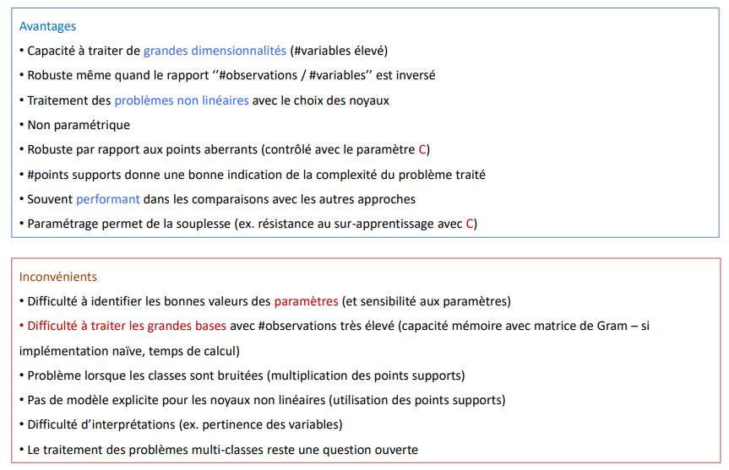
SVMs Pros and Cons
Support Vector Machines (SVM)
Benefits
- Ability to handle large dimensionalities (high #variables)
- Robust even when the ratio ''#observations / #variables'' is reversed
- Treatment of nonlinear problems with the choice of kernels
- Non-parametric
- Robust against outliers (controlled with the C parameter)
- Support points give a good indication of the complexity of the problem treated
- Often performs well in comparisons with other approaches
- Parameterization allows flexibility (e.g., resistance to overlearning with C)
Disadvantages
- Difficulty to identify the right parameter values (and sensitivity to parameters)
- Difficulty to process large databases with very high #observations (memory capacity with Gram matrix - if naive implementation, computation time)
- Problem when classes are noisy (multiplication of support points)
- No explicit model for non-linear kernels (use of support points)
- Difficulty of interpretations (e.g., relevance of variables)
- The treatment of multi-class problems remains an open question

Slide 44
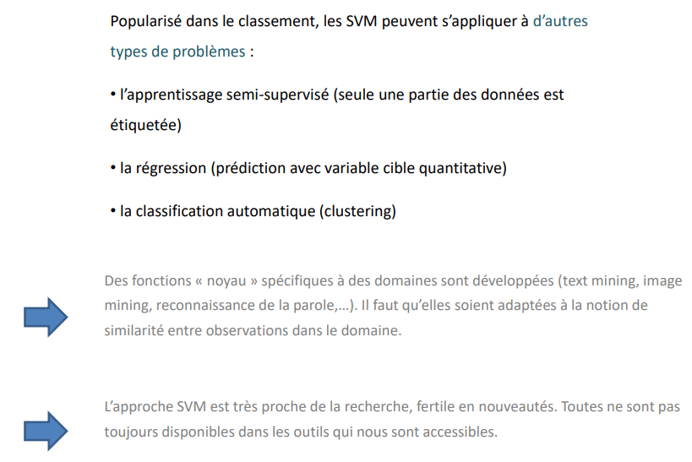
SVMs Extensions
Support Vector Machines (SVM)
Popularized in ranking, SVMs can be applied to other types of problems:
- semi-supervised learning (only part of the data is labelled)
- regression (prediction with quantitative target variable)
- automatic classification (clustering)
Domain-specific "core" functions are developed (text mining, image mining, speech recognition, etc.). They must be adapted to the notion of similarity between observations in the domain.
The SVM approach is very close to research, fertile in novelties. Not all of them are available in the tools that are accessible to us.

